Slide 1

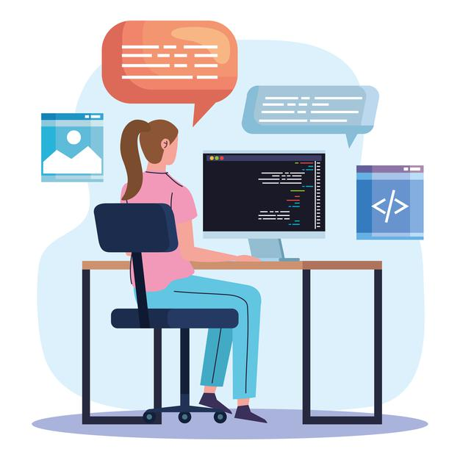
Ashwag
Zabani
Home About Me What I do Projects Contact Me
Ashwag
Zabani
Software Engineer
Hi, I ‘m a Software Engineer from Saudi Arabia, Jeddah. I have rich trainee experiences in Web Development based on-hands projects, also, I’m good at Javascript, Html, Css and React. I love to talk with you about our unique.

Slide 2
Ashwag
Zabani
Home About Me What I do Projects Contact Me
About Me
MY STORY
I’m graduate of Computer Science from King Abdulaziz University in 2018. Recently I finished a full-time internship in the Software Engineer immersive program from General Assembly.
My internship at General Assembly afforded me the crucial skills that I learned from some of the best professionals in web development.
During the course of my three months internship, I developed enthusiasm and passion for web development. Where I learned some web techniques, and I executed some projects individually and collaboratively.

Slide 3
Ashwag
Zabani
Home About Me What I do Projects Contact Me
What I DO
I’m graduate of Computer Science from King Abdulaziz University in 2018. Recently I finished a full-time internship in the Software Engineer immersive program from General Assembly.
My internship at General Assembly afforded me the crucial skills that I learned from some of the best professionals in web development.
During the course of my three months internship, I developed enthusiasm and passion for web development. Where I learned some web techniques, and I executed some projects individually and collaboratively.

Slide 4
Ashwag
Zabani
Home About Me What I do Projects Contact Me
Projects

Slide 5
Ashwag
Zabani
Download CV
About What I do Experiences Projects
About Me
MY STORY
I’m graduate of Computer Science from King Abdulaziz University in 2018. Recently I finished a full-time internship in the Software Engineer immersive program from General Assembly. I interested in web development and I am seeking a job as Software Engineer My internship at General Assembly afforded me the crucial skills that I learned from some of the best professionals in web development. During the course of my three months internship, I developed enthusiasm and passion for web development. Where I learned some web techniques such as: HTML, CSS, JavaScript, Python, ReactJs, Django, Postgres, MongoDB, and I executed some projects individually and collaboratively.
The time spent there opened my eyes further to the creative challenges required in this field. I rapidly adapted to team members and worked with them directly.

Slide 6
Ashwag
Zabani
Download CV
About What I do Experiences Projects
About Me
MY STORY
I’m graduate of Computer Science from King Abdulaziz University in 2018. Recently I finished a full-time internship in the Software Engineer immersive program from General Assembly. I interested in web development and I am seeking a job as Software Engineer My internship at General Assembly afforded me the crucial skills that I learned from some of the best professionals in web development. During the course of my three months internship, I developed enthusiasm and passion for web development. Where I learned some web techniques such as: HTML, CSS, JavaScript, Python, ReactJs, Django, Postgres, MongoDB, and I executed some projects individually and collaboratively.
The time spent there opened my eyes further to the creative challenges required in this field. I rapidly adapted to team members and worked with them directly.

Slide 7
Ashwag
Zabani
Download CV
About What I do Experiences Projects
About Me
MY STORY
I’m graduate of Computer Science from King Abdulaziz University in 2018. Recently I finished a full-time internship in the Software Engineer immersive program from General Assembly. I interested in web development and I am seeking a job as Software Engineer My internship at General Assembly afforded me the crucial skills that I learned from some of the best professionals in web development. During the course of my three months internship, I developed enthusiasm and passion for web development. Where I learned some web techniques such as: HTML, CSS, JavaScript, Python, ReactJs, Django, Postgres, MongoDB, and I executed some projects individually and collaboratively.
The time spent there opened my eyes further to the creative challenges required in this field. I rapidly adapted to team members and worked with them directly.

Slide 9
A
Z

